Slide 1


Project 1 – Technology Stock Analysis
UofT Bootcamp Data Analytics

Slide 2


Outline
1- Project Background/Proposal
2- Project Tasks Steps
3- Project Results & Conclusions

Slide 3



Project Introduction
Project Description/Outline:
Datasets: Top 10 Technology & E-commerce companies listed on NASDAQ, and NYSE
Tickers: [“APPL”,”AMZN”,”CSCO”,”EBAY”, “GOOG”,”IBM”,”MSFT”]
Time Horizon: 2011-2021
Data source: https://www.kaggle.com/datasets/paultimothymooney/stock-market-data
Goals/Objectives
Track and visualize historical stock ticker performance
Highlight Best Performing Ticker historically
Highlight most Volatile Stock historically
Identify Correlation between Average Close Price and Earning Per Share (EPS)
Notes:
Mohamed

Slide 4
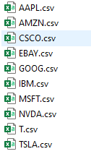
Project Tasks/Steps
Decompose “The Ask”: Which companies?
Identify Data Sources: Datasets Collection (Kaggle, Stock Markets websites)
Define Strategy and Metrics: Close Price and EPS
Build Data Retrieval Plan: MPL Finance API,
Retrieve the data: from CSV to Pandas
Assemble and Clean the data: Import the data from .csv files into a DataFrame (10 csv files)
Analyze for Trends: Summary Statistics Datasframe & Visulaization (volatility)
Limitations
Notes:
Mohamed

Slide 5
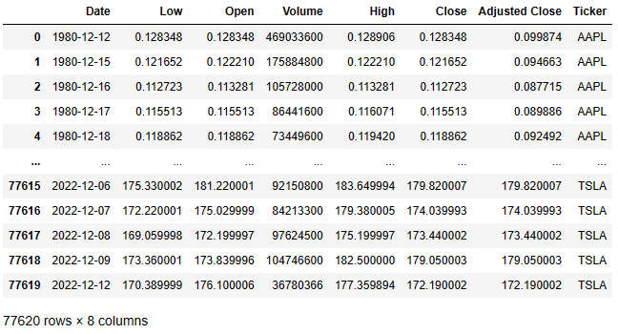
Project Results: Raw Data
Table 1: Raw DateFrame from CSV
Notes:
Mohamed

Slide 6
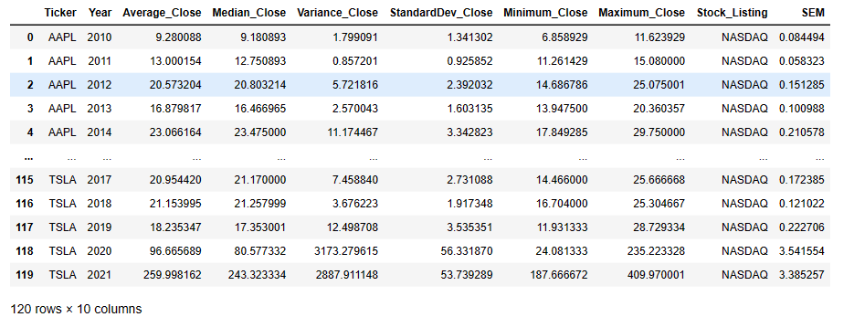
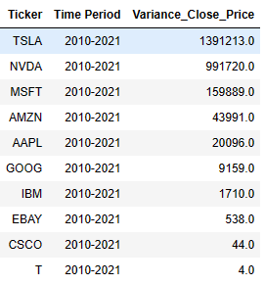
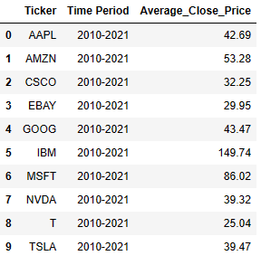
Project Results: Statistical Summary (Close_Price)
Table 2: Cleaned DataFrame, Statistical Summary (Close_Price)
Notes:
Mohamed

Slide 7
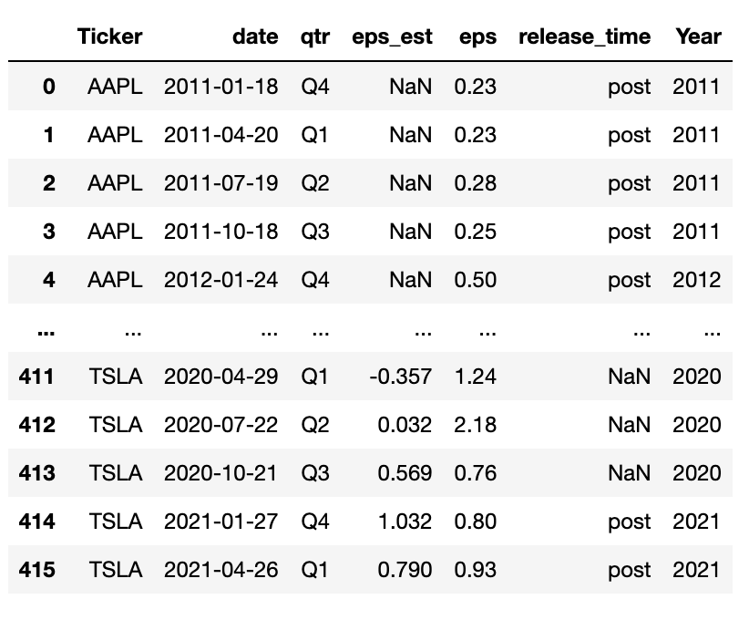
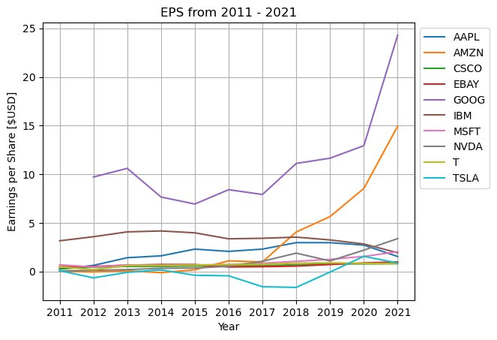
Project Results: Statistical Summary (EPS)
Figure 1: Earnings per Share between 2011-2021 for Tech. Companies
Notes:
Salvador

Slide 8
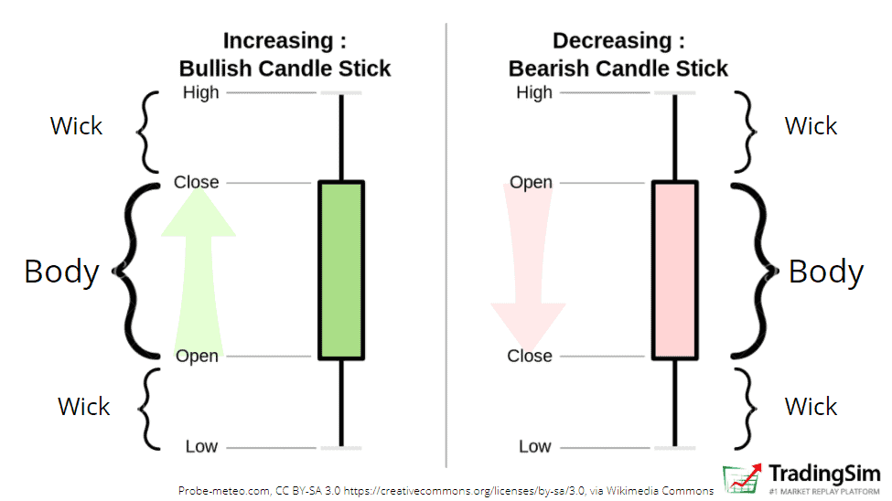

MplFinance API Application
Notes:
Mohamed Lutfor

Slide 9
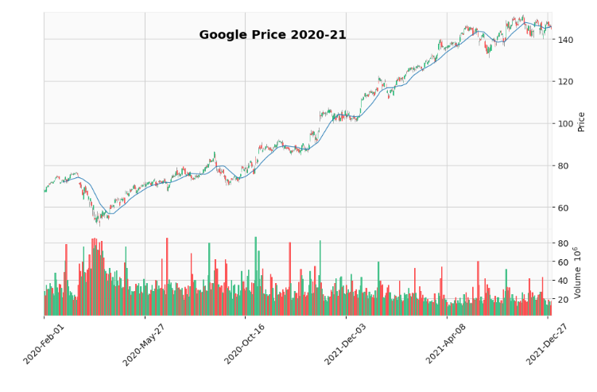
Project Results: MPL Finance Application
Figure 2: Google Candlestick Graph between 2020 to 2021
Notes:
Mohamed Lutfor

Slide 10
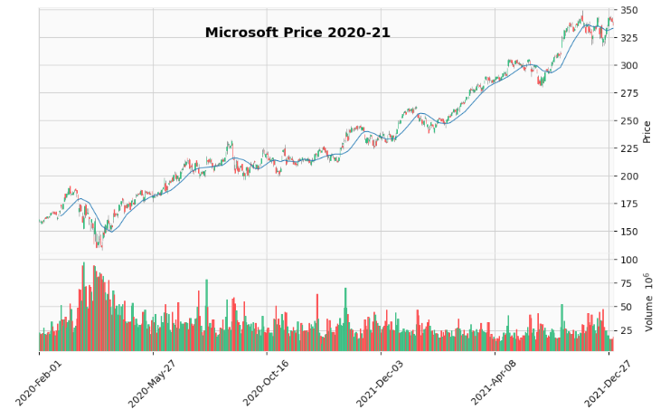
Project Results: MPL Finance Application
Figure 3: Microsoft Candlestick Graph between 2020 to 2021
Notes:
Mohamed Lutfor

Slide 11
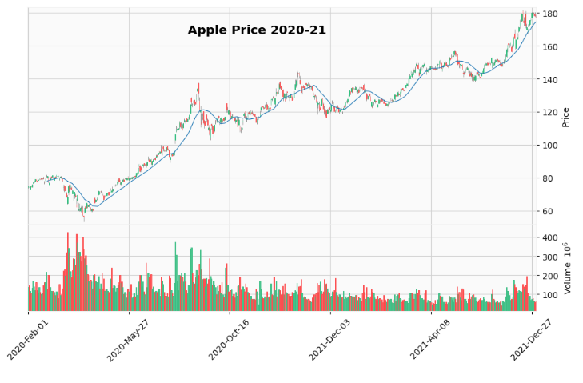
Project Results: MPL Finance Application
Figure 4: Apple Candlestick Graph between 2020 to 2021
Notes:
Mohamed Lutfor

Slide 12
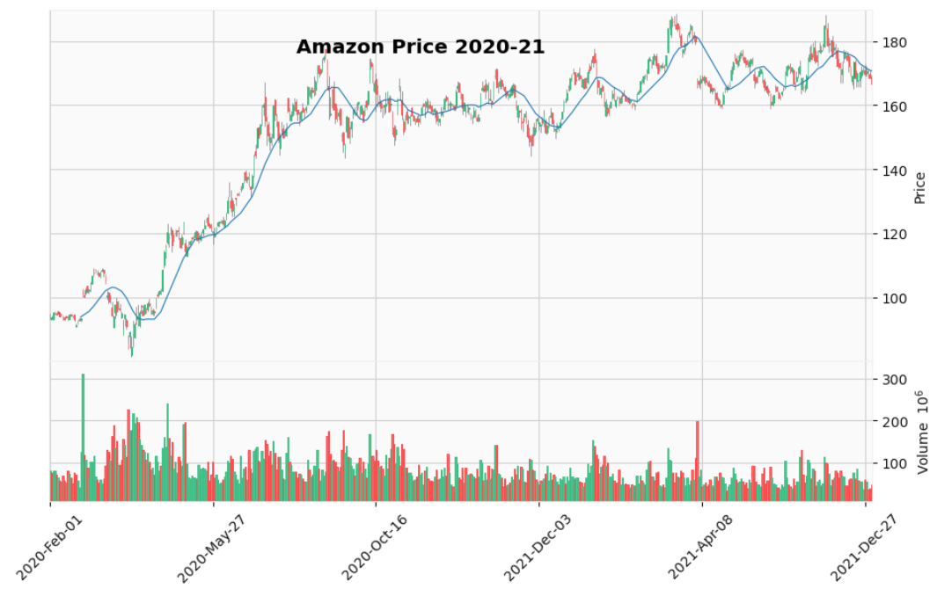
Project Results: MPL Finance Application
Figure 5: Amazon Candlestick Graph between 2020 to 2021
Notes:
Mohamed Lutfor

Slide 13
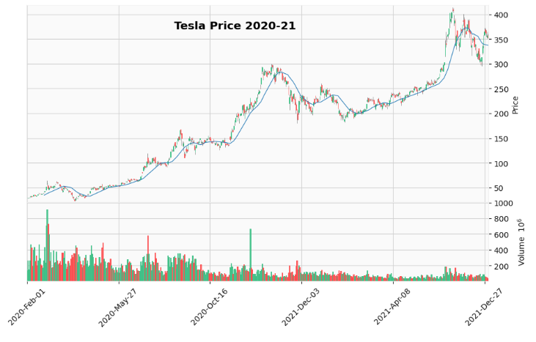
Project Results: MPL Finance Application
Figure 6: Tesla Candlestick Graph between 2020 to 2021
Notes:
Mohamed Lutfor

Slide 14
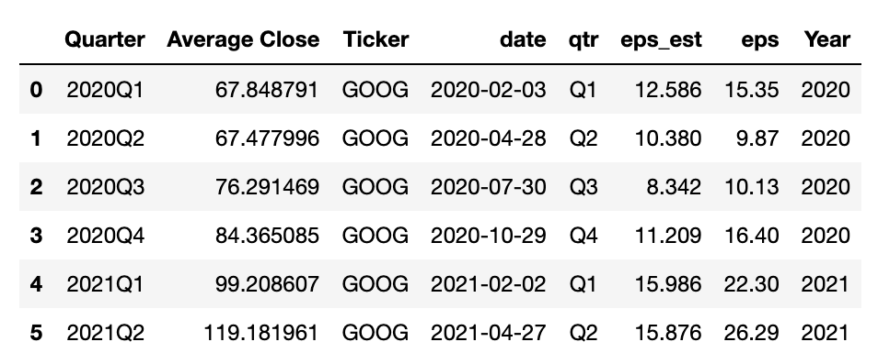
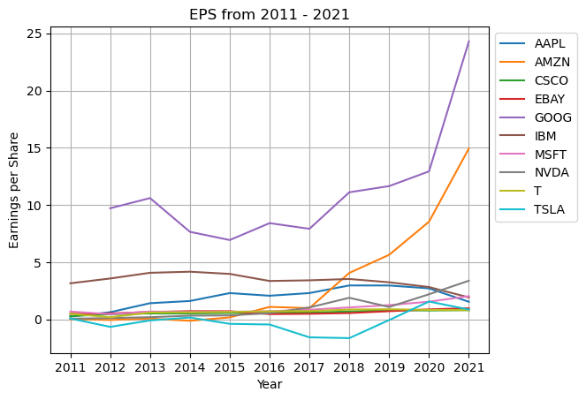
Project Results: Google Analysis
Table 4 : Google Quarterly Close Price view (2020-2022)
Notes:
Mohamed

Slide 15
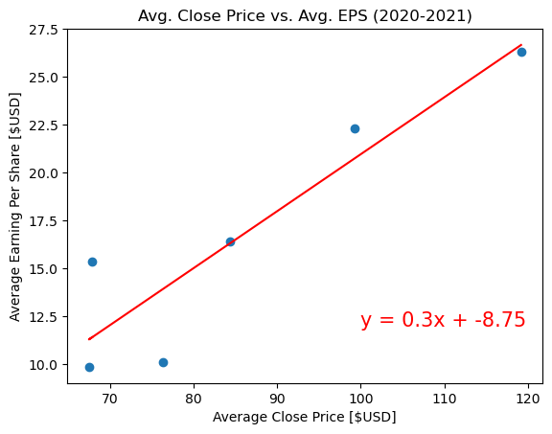
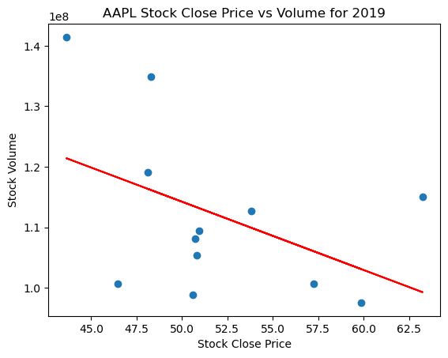
Project Results : Correlations
Strong Positive Correlation between Average Close Price and EPS (rvalue: 0.9161849722975483)
Moderate Negative Correlation between AAPL Stock Close Price and Stock Volume (rvalue -0.4580926996775942)
Notes:
Salvador

Slide 16
Project Conclusions
Overall, Google followed by Amazon provided the highest Earning Per share between 2011-2021
Tesla had the highest-volatility whereas T (AT&T) had the lowest volatility
Overall, E-bay had the steadiest behavior in EPS, and it had the third smallest variance in close price
Limitations:
EPS Data Source
Outliers were included
Correlation: More data is need to validate the analysis
Notes:
Salvador

Slide 17
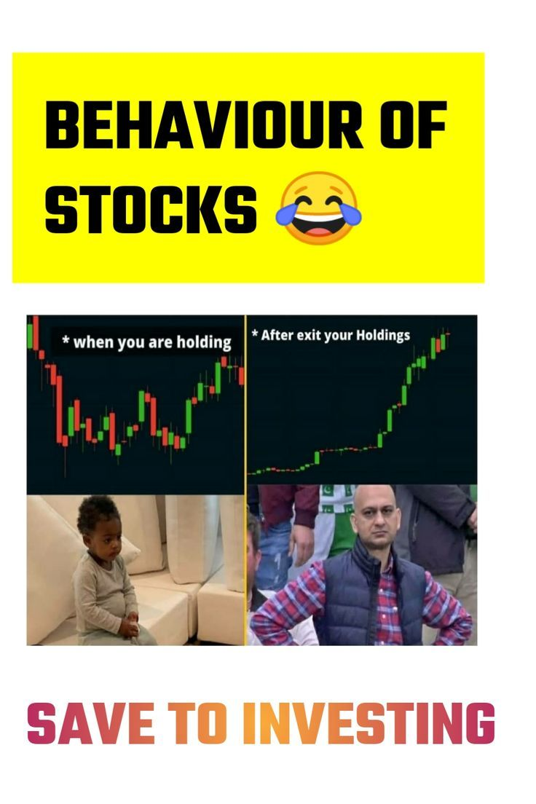


Slide 18

Thank you

